Slide 1
AVERAGE EFFECT
Mean centred lyric orientation covariate
22 subjects

Slide 2
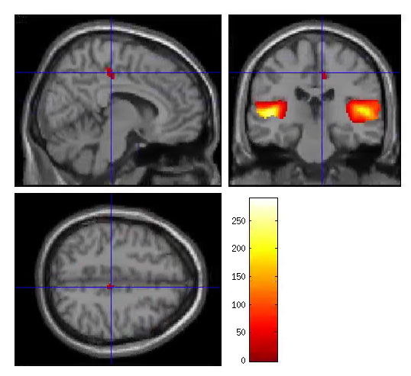
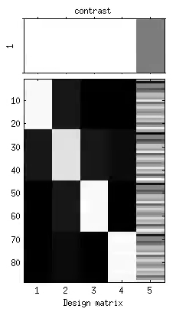
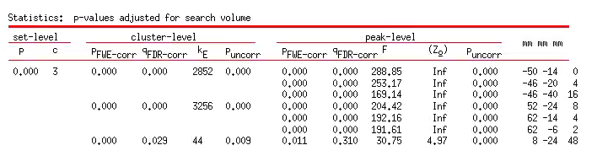
S1TBL_lyror_mean_22subj
Extent threshold = 19
P<0.05 FWE cor
ROI1
ROI2
ROI3

Slide 3
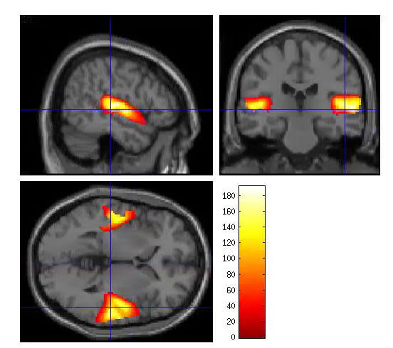
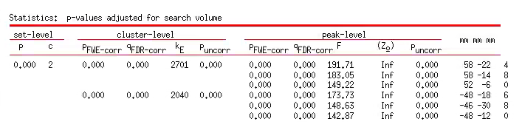
S2TBL_lyror_mean_22subj
Extent threshold = 22
P<0.05 FWE cor
ROI1
ROI2

